Slide 1


Data Science
MODULE II

Slide 2
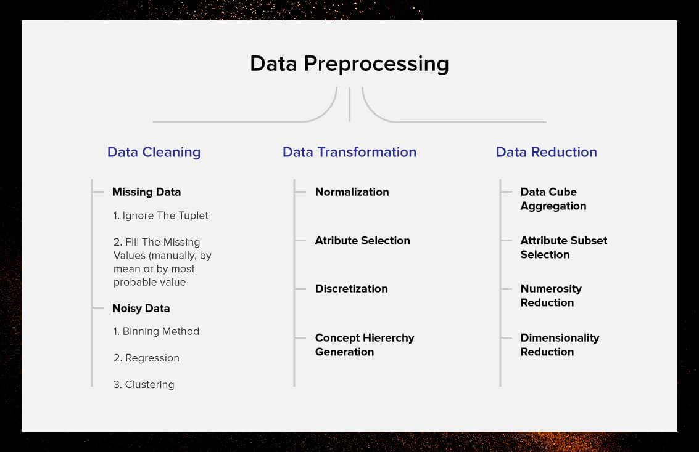
Data Preprocessing Overview

Slide 3
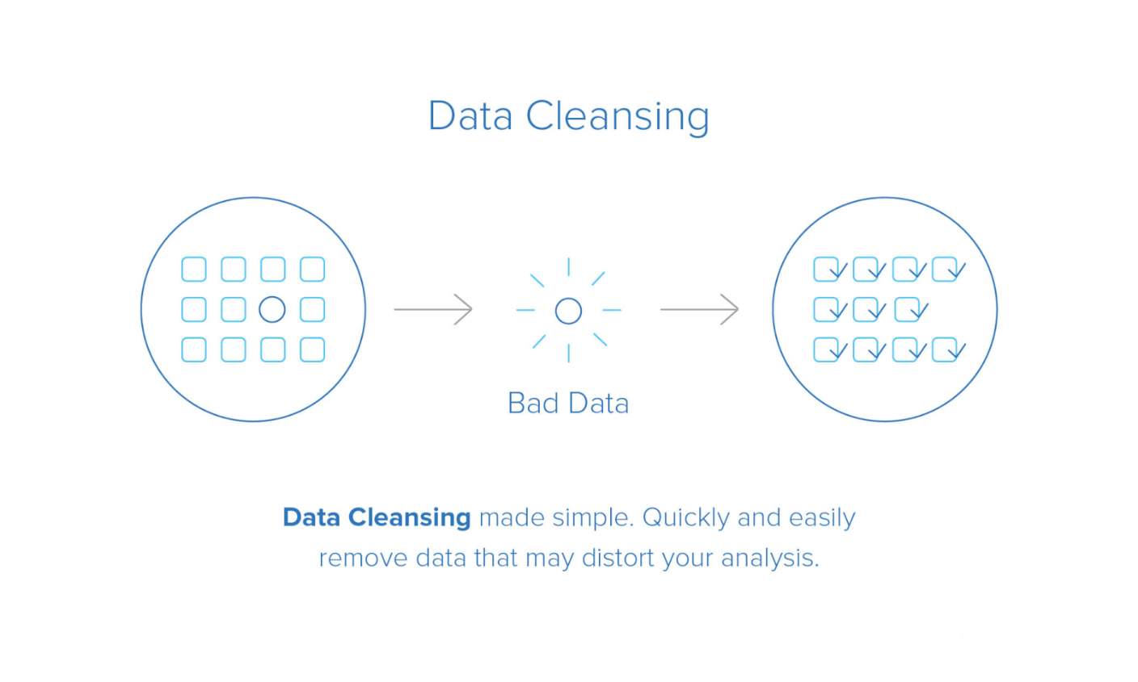
Data Cleaning

Slide 4
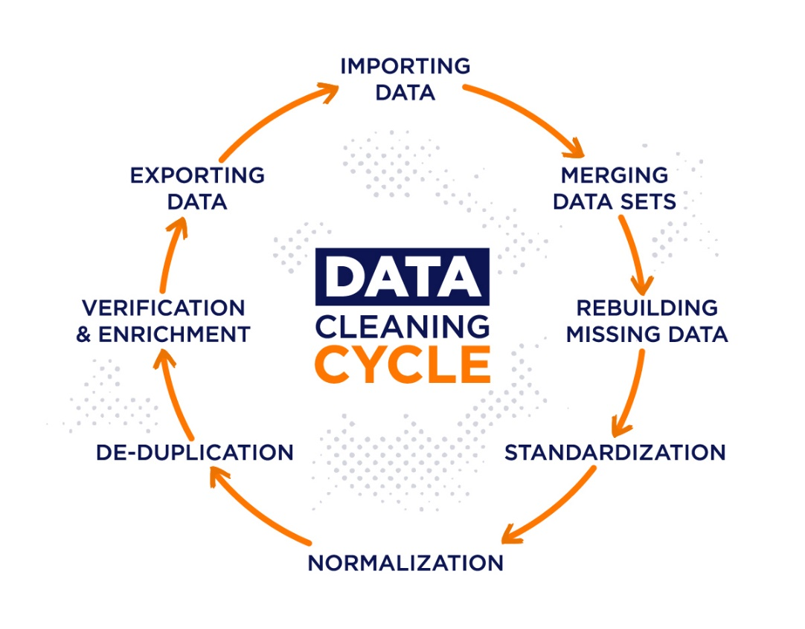
Data Cleaning

Slide 5
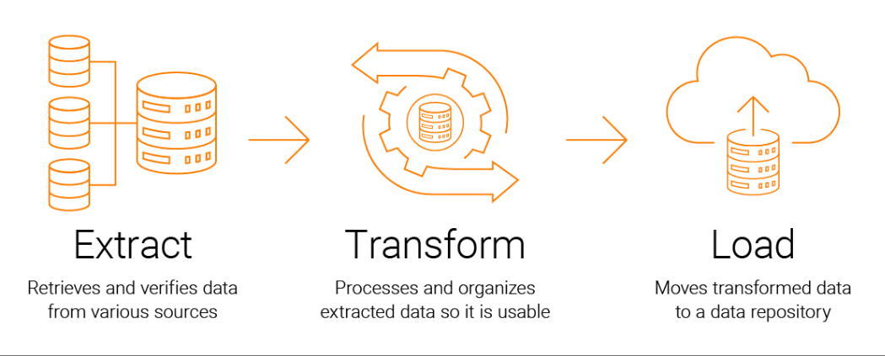
ETL Process

Slide 6
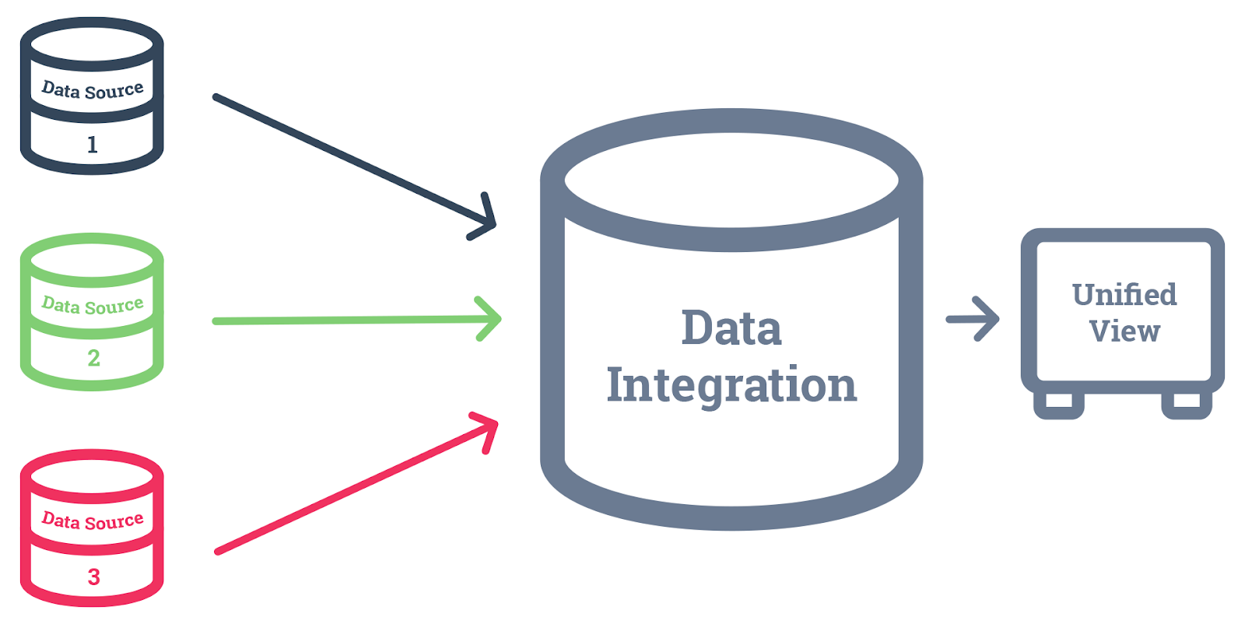
Data Integration

Slide 7
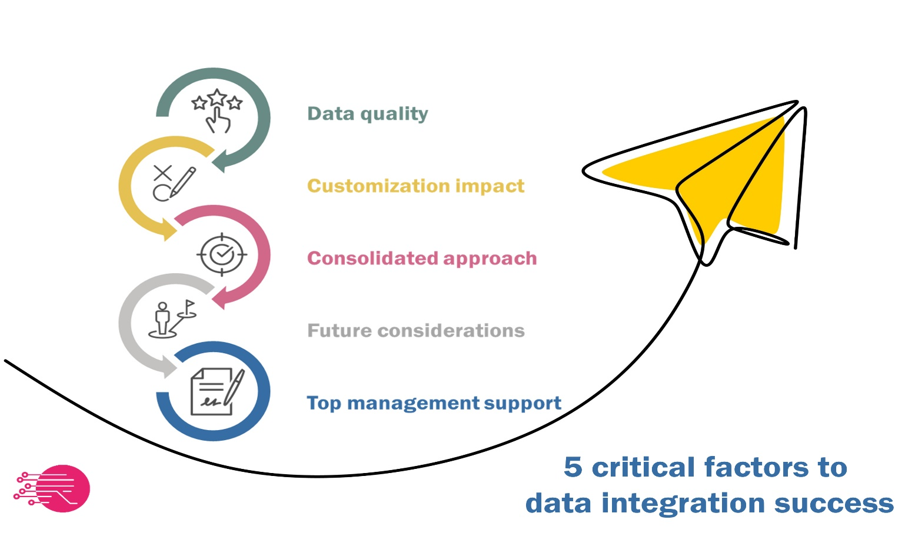
Data Integration

Slide 8
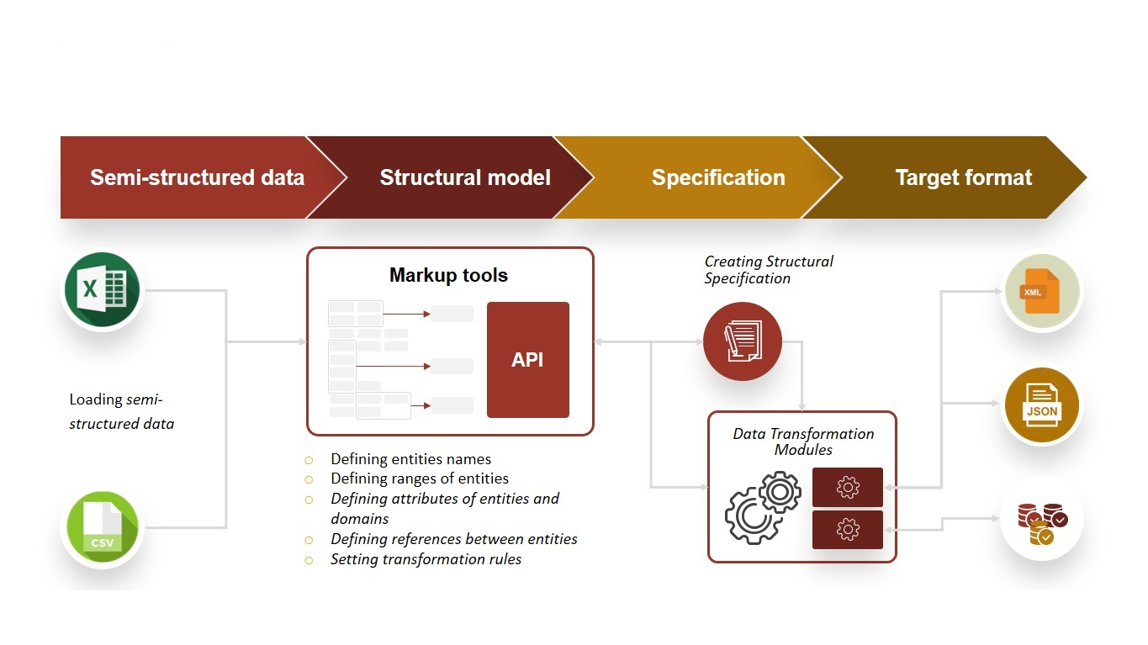
Data Transformation

Slide 9
Data Transformation

Slide 10
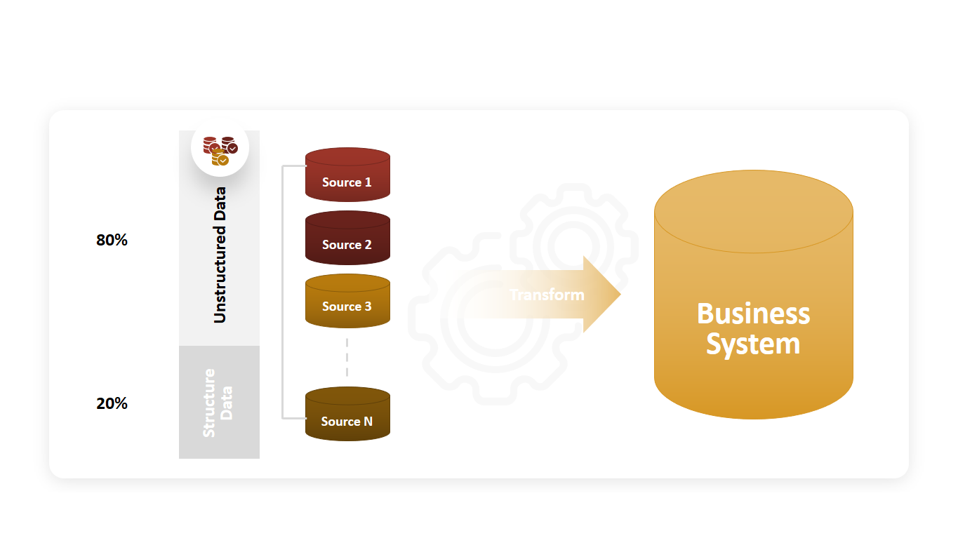
Data Transformation

Slide 11
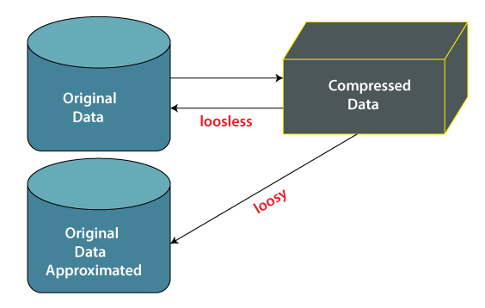
Data Reduction

Slide 12
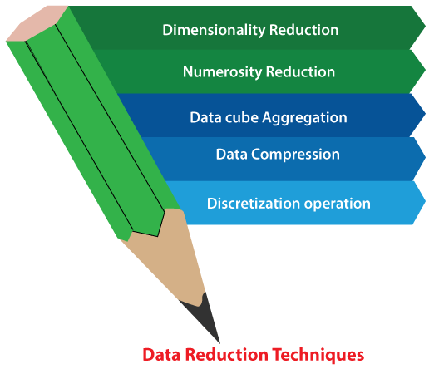
Data Reduction

Slide 13
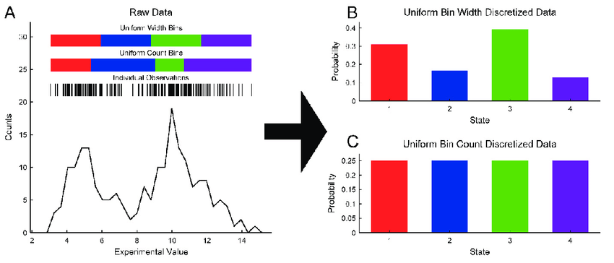
Discretization

